Slide 1

BY:
SALMAN

Slide 2
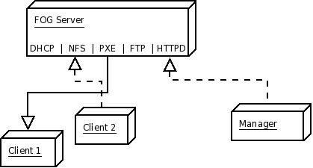
FOG?
Notes:
Fog is an open source linux based computer imaging solution for Windows XP, Vista, 7. FOG server provides DHCP, NFS, PXE, WOL, and etc. services for the clients. FOG can run on any Linux Distro. In the example above Client 1 is performing a PXE Boot and if there is a task assigned for it on the fog server it will be executed and if not it will boot from the hard disk. Client 2 is uploading an image using NFS to the FOG server. The manager can be any machine that can access FOG through a web browser.

Slide 3
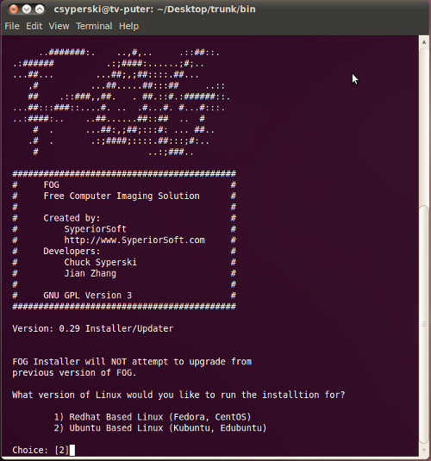
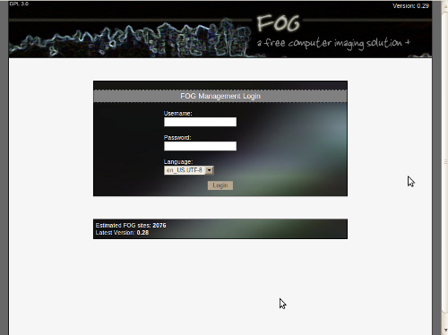
Installation
Default info: username: fog password: password Access FOG via Browser: http://localhost/fog/management Installation Instruction Modifying existing DHCP servers to work with FOG
Notes:
- Installed it on Ubuntu 10.04
Fog installation prompts for installation mode N (normal server) S (storage server), choose N for first installation.
Enter IP address for the FOG server same one that was statically assigned for interface
Use FOG server for dhcp services Y or N
Etc.
Default info username: fog password: password
Access fog through a web browser by entering http://localhost/fog/management

Slide 4
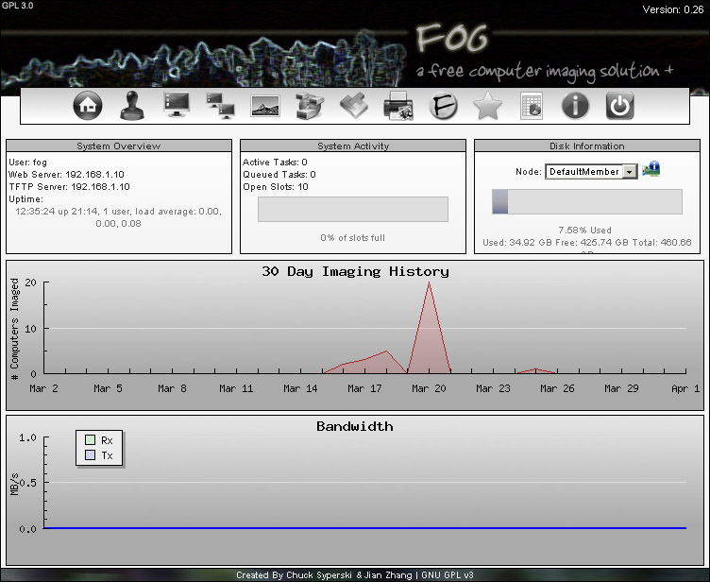
Management
Notes:
This is the where the FOG server is administered from.
Icons Starting from left to right
Home/Dashboard - This is the home screen of the FOG management portal.
Users - Individual administrators of the FOG resources.
Hosts - This section houses the hosts, which are the pcs to be imaged or to extract images from.
Groups - This section houses groups, which are similar PCS’ that need tasks done en-masse.
Images - This section allows you to manage the image files stored on the FOG server.
Storage Management - This section allows you to add/remove storage nodes from the FOG system.
Snap-ins - This section provides ways to automate various post-imaging tasks, not covered in this document
Printers' - This section allows for management of printers, allowing you create printer objects that can later be assigned to hosts or groups.
FOG Service Configuration' - This section allows you to control how the client service functions.
Tasks - This section allow you to perform imaging tasks such as acquiring or deploying images.
Reports - Reports let you pull information from the FOG database either as HTML, pdf, or csv.
Info/Misc - The section has the rest of the settings that don't fit anywhere else like the kernel updater and the client service updater.
Logoff - Click this to log off of the Fog web UI.

Slide 5
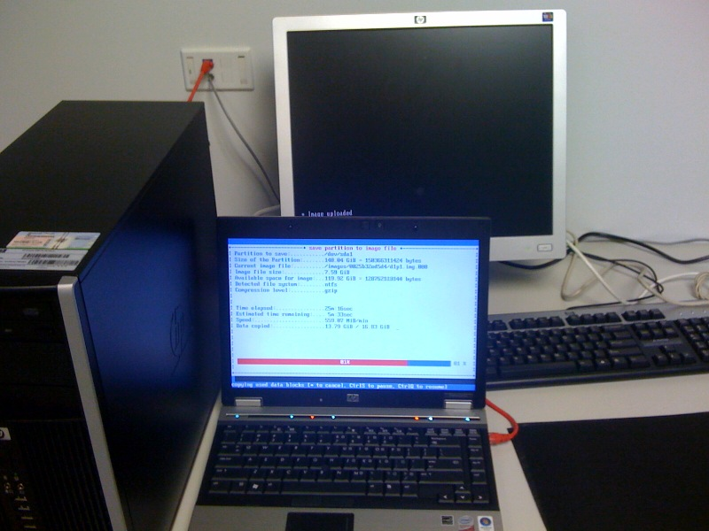
Now What?
Host Registration
Upload Image
Deploy Image
Notes:
Now that FOG is installed and running we can go ahead with the process of deploying images. The host has to be registered with the server, an image uploaded to the fog server and finally an image can be used to deploy to hosts.

Slide 6
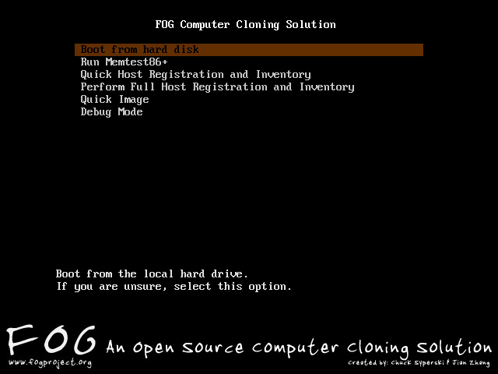
Registration
Adding Host
Notes:
The three ways to register or add a host is manually through the host section on the FOG server, Quick Registration, and Full Registration.
For manual registration a host name and mac address is required.
Quick Registration, gives the host a name, an ip address, and sends that information along with the mac address to the fog server no input is required.
Full Registration gives many more options such as assigning an OS to the machine, an image to the machine if one already exists on the server, and deploying the image.

